Slide 1

Frailty models
Steve Simon for
Notes:
Analyzing Repeated Measures Data Workshop: Module 5 The Linear Mixed Model
Copyright 2011 The Analysis Factor http://TheAnalysisFactor.com
1

Slide 2
Abstract
Lecture 7.
Lecture 7. Frailty models. You can incorporate multiple events per patient and account for center effects using frailty models, the survival data analysis equivalent to mixed models in linear regression. You’ll see how to define random effects and how to fit and interpret these models.

Slide 3
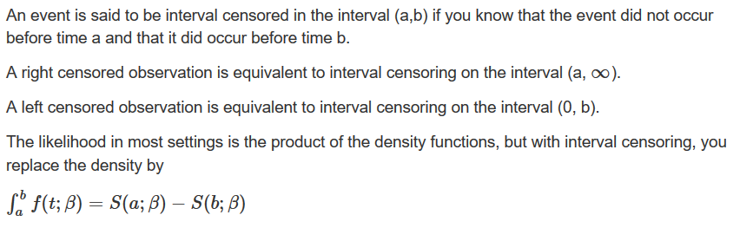
Interval censored data

Slide 4
Interval censored data
Left truncation
In most studies, patients are considered part of the risk set from time 0 to the time that they either die or are censored. But sometimes patients start contributing information about survival only from a certain point forward. This is left truncation.
Example: Patients who die in the hospital are excluded from your sample. A patient contributes to the risk set from the day of discharge onward. Setting the time of discharge to t=0 will mix patients with short and long lengths of stay.

Slide 5
Interval censored data
Left censored and left truncated are opposites
Right censored. Event occurred sometime after last observed time.
Left censored. Event occurred sometime before the first observed time.
Left truncated. The patient does not contribute information about the risk of the event prior to the first observed time.

Slide 6
Psychiatric dataset
math.usu.edu/jrstevens/biostat/projects2013/pres_LeftTruncation.pdf
sex age time death age2
1 female 51 1 death 52
2 female 58 1 death 59
3 female 55 2 death 57
4 female 28 22 death 50
5 male 21 30 censor 51
6 male 19 28 death 47

Slide 7
Psychiatric dataset
Descriptive statistics
sex male female
10 15
death censor death
11 14

Slide 8
Psychiatric dataset
Descriptive statistics
age Min. 1st Qu. Median Mean 3rd Qu. Max.
19.00 29.00 33.00 35.56 43.00 58.00
age2 Min. 1st Qu. Median Mean 3rd Qu. Max.
47.00 57.00 61.00 61.72 67.00 76.00
age2-age Min. 1st Qu. Median Mean 3rd Qu. Max.
1.00 22.00 30.00 26.16 35.00 40.00

Slide 9
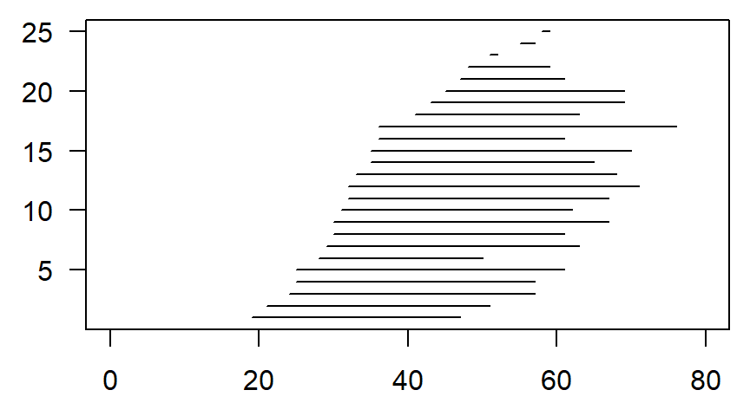
Psychiatric dataset

Slide 10
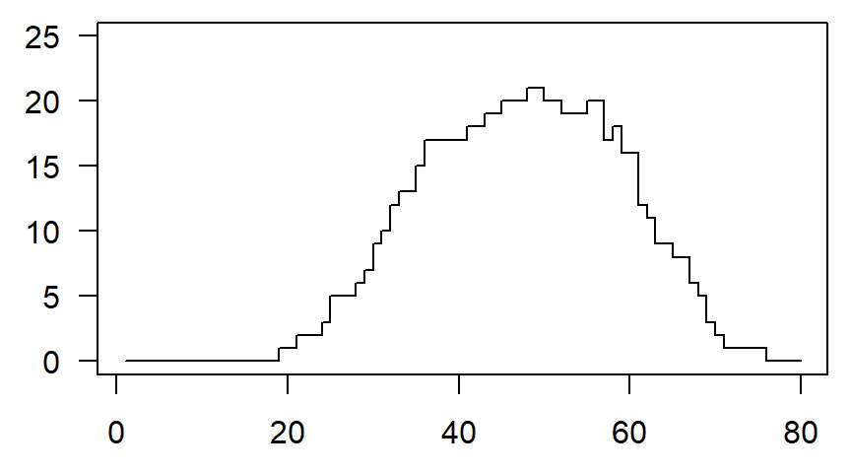
Psychiatric dataset, patients at risk

Slide 11
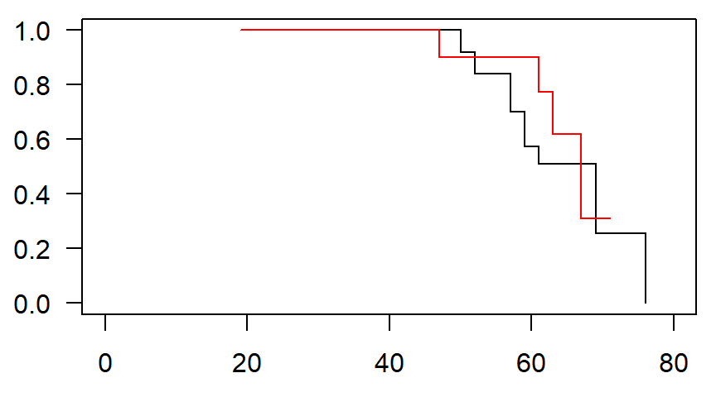
Psychiatric survival curves, red=males

Slide 12
Frailty/cluster models
Settings
Frailty/cluster models account for correlation within a group.
Multiple events for the same person.
Multiple sites on the same person.
Multiple people in the same family
Multiple animals in the same litter.
Multiple visitors in the same hospital
Multiple students in the same classroom/school.

Slide 13
Ashkenazi data set
Description
This is a random subset of data from the Struewing et al. (1997) study of Ashkenazi jews and breast cancer. The subset consists of pairs of first-degree female relatives who are also first degree relatives of a proband.
Struewing JP, Hartge P, Wacholder S, Baker SM, Berlin M, McAdams M, Timmerman MM, Brody LC, and Tucker MA (1997) The risk of cancer associated with specific mutations of BRCA1 and BRCA2 among ashkenazi jews. New England Journal of Medicine 336, 1401-1408.)

Slide 14
Ashkenazi data set
3920 observations and 4 variables
famID: family ID indicator
brcancer: 1 if subject had breast cancer, 0 if not
age: Age at onset of breast cancer, or current age if no breast cancer
mutant: 1 if first degree relative proband was a BRCA mutation carrier, 0 if not

Slide 15
Ashkenazi data set
First six rows
famID brcancer age mutant
1 1 0 73 0
2 1 0 40 0
3 7 0 48 0
4 7 0 25 0
5 8 0 56 0
6 8 0 55 0

Slide 16
Ashkenazi data set
Descriptive statistics
brcanacer 0 1
3447 473
mutant 0 1
3830 90
age Min. 1st Qu. Median Mean 3rd Qu. Max.
1.00 45.00 59.00 58.63 73.00 100.00

Slide 17
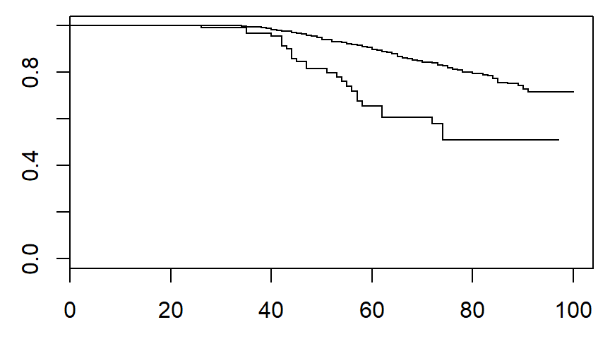
Ashkenazi survival curves, lower curve is mutant

Slide 18
Rats data set
Description
Rat treatment data from Mantel et al. Three rats were chosen from each of 100 litters, one of which was treated with a drug, and then all followed for tumor incidence.
N. Mantel, N. R. Bohidar and J. L. Ciminera. Mantel-Haenszel analyses of litter-matched time to response data, with modifications for recovery of interlitter information. Cancer Research, 37:3863-3868, 1977.

Slide 19
Rats data set
300 observations and 5 variables.
litter: litter number from 1 to 100
rx: treatment,(1=drug, 0=control)
time: time to tumor or last follow-up
status: event status, 1=tumor and 0=censored
sex: male or female

Slide 20
Rats data set
First six rows
litter rx time status sex
1 1 1 101 0 f
2 1 0 49 1 f
3 1 0 104 0 f
4 2 1 91 0 m
5 2 0 104 0 m
6 2 0 102 0 m

Slide 21
Rats data set
Descriptive statistics
rx 0 1
200 100
status 0 1
258 42
sex f m
150 150
time Min. 1st Qu. Median Mean 3rd Qu. Max.
23.00 80.75 98.00 90.44 104.00 104.000

Slide 22
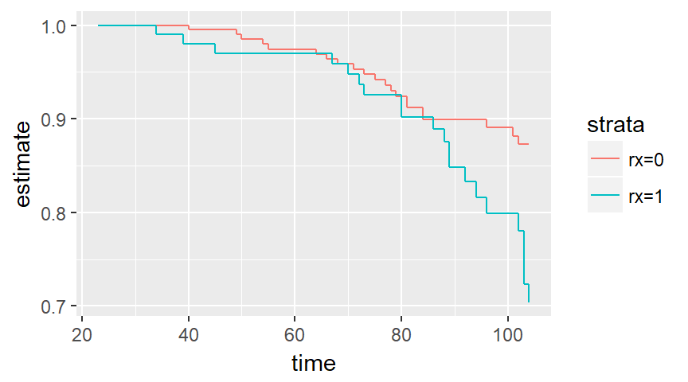
Rats data set

Slide 23
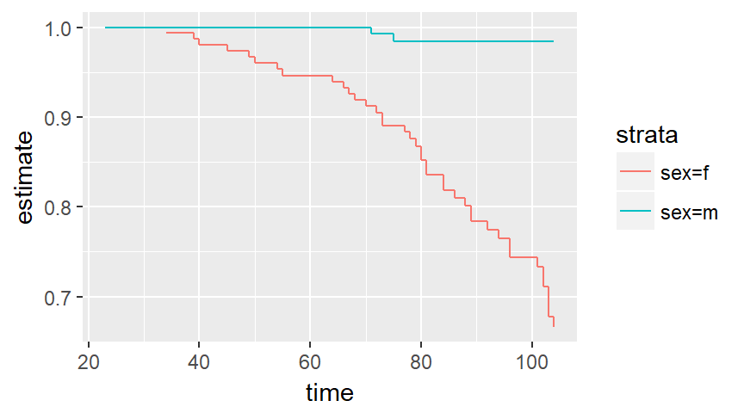
Rats data set

Slide 24
Diabetes data set
Description
The data was collected to test a laser treatment for delaying blindness in patients with diabetic retinopathy. The subset of 197 patiens given in Huster et al. (1989) is used.
Huster W.J. and Brookmeyer, R. and Self. S. (1989) Modelling paired survival data with covariates, Biometrics 45, 145-56.

Slide 25
Diabetes data set
394 observations and 7 variables.
id: a numeric vector. Patient code.
agedx: a numeric vector. Age of patient at diagnosis.
time: a numeric vector. Survival time: time to blindness or censoring.
status: a numeric vector code. Survival status. 1: blindness, 0: censored.
trteye: a numeric vector code. Random eye selected for treatment. 1: left eye 2: right eye.
treat: a numeric vector. 1: treatment 0: untreated.
adult: a numeric vector code. 1: younger than 20, 2: older than 20.

Slide 26
Diabetes data set
First six rows
id time status trteye treat adult agedx
1 5 46.24967 0 2 1 2 28
2 5 46.27553 0 2 0 2 28
3 14 42.50684 0 1 1 1 12
4 14 31.34145 1 1 0 1 12
5 16 42.30098 0 1 1 1 9
6 16 42.27406 0 1 0 1 9

Slide 27
Diabetes data set
Descriptive statistics
status 0 1
239 155
trteye 1 2
178 216
treat 0 1
197 197
adult 1 2
228 166

Slide 28
Diabetes data set
Descriptive statistics
time Min. 1st Qu. Median Mean 3rd Qu. Max.
0.3154 13.9851 38.8293 35.6105 54.2951 75.0260
agedx Min. 1st Qu. Median Mean 3rd Qu. Max.
1.00 10.00 16.00 20.78 30.00 58.00

Slide 29
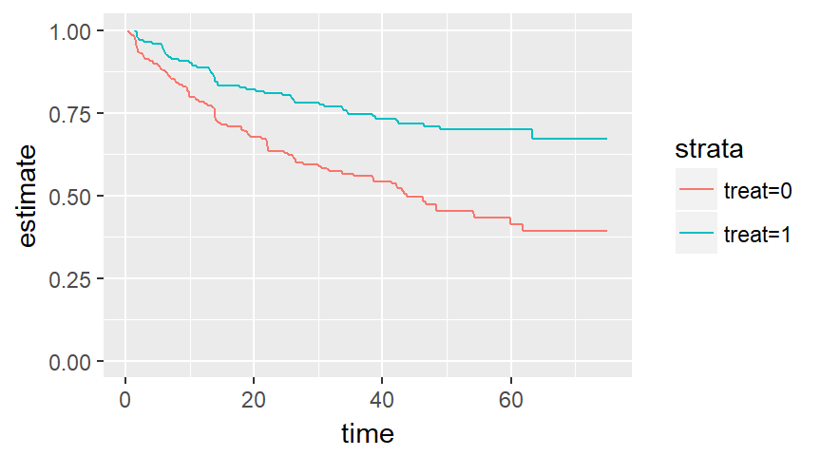
Diabetes data set

Slide 30
Kidney data set
Description
Data on the recurrence times to infection, at the point of insertion of the catheter, for kidney patients using portable dialysis equipment. Catheters may be removed for reasons other than infection, in which case the observation is censored. Each patient has exactly 2 observations.
CA McGilchrist, CW Aisbett (1991), Regression with frailty in survival analysis. Biometrics 47, 461–66.

Slide 31
Kidney data set
76 observations and 7 variables.
patient: id
time: time
status: event status
age: in years
sex: 1=male, 2=female
disease: disease type (0=GN, 1=AN, 2=PKD, 3=Other)
frail: frailty estimate from original paper

Slide 32
Kidney data set
First six rows.
id time status age sex disease frail
1 1 8 1 28 1 Other 2.3
2 1 16 1 28 1 Other 2.3
3 2 23 1 48 2 GN 1.9
4 2 13 0 48 2 GN 1.9
5 3 22 1 32 1 Other 1.2
6 3 28 1 32 1 Other 1.2

Slide 33
Kidney data set
Descriptive statistics.
status 0 1
18 58
sex 1 2
20 56
disease Other GN AN PKD
26 18 24 8

Slide 34
Kidney data set
Descriptive statistics.
time Min. 1st Qu. Median Mean 3rd Qu. Max.
2.0 16.0 39.5 101.6 149.8 562.0
age Min. 1st Qu. Median Mean 3rd Qu. Max.
10.0 34.0 45.5 43.7 54.0 69.0
frail Min. 1st Qu. Median Mean 3rd Qu. Max.
0.200 0.600 1.100 1.184 1.500 3.000
Min. 1st Qu. Median Mean 3rd Qu. Max.
0.200 0.600 1.100 1.184 1.500 3.000

Slide 35
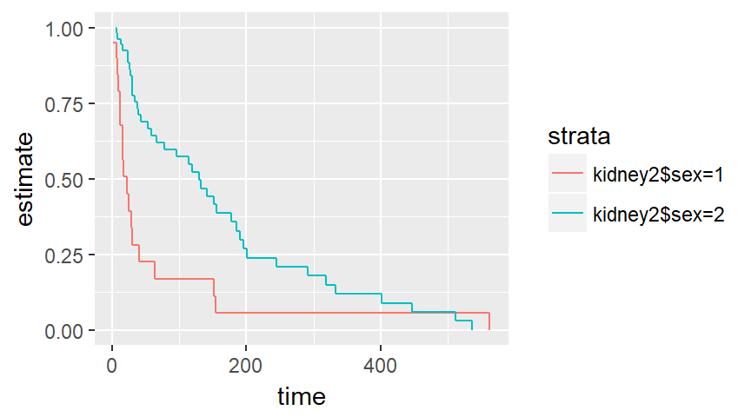
Kidney data set

Slide 36
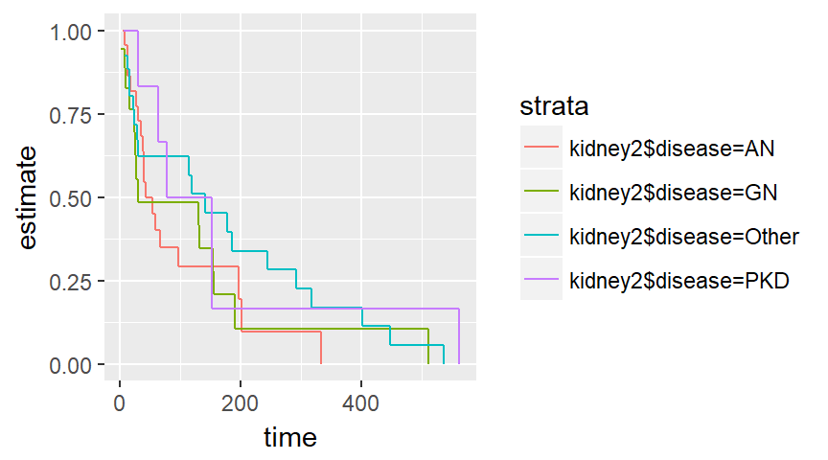
Kidney data set

Slide 37
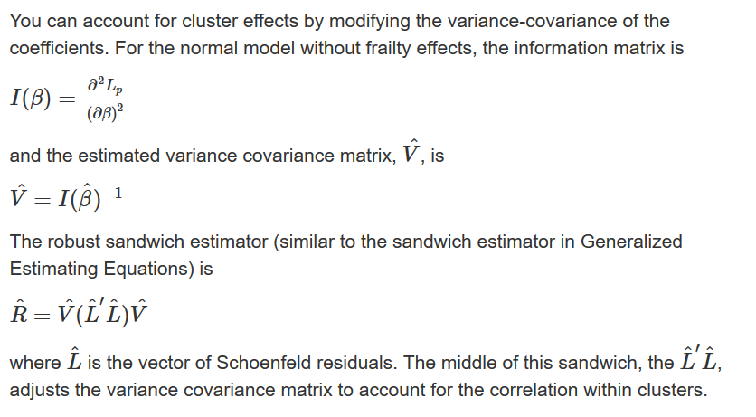
Cluster models

Slide 38
Ashkenazi data set
Cluster model
coef exp(coef) se(coef) robust se z p
mutant 1.191 3.290 0.198 0.202 5.89 4e-09
Likelihood ratio test=25.9 on 1 df, p=3.55e-07
n= 3920, number of events= 473

Slide 39
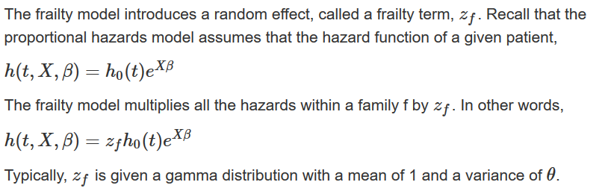
Frailty models

Slide 40
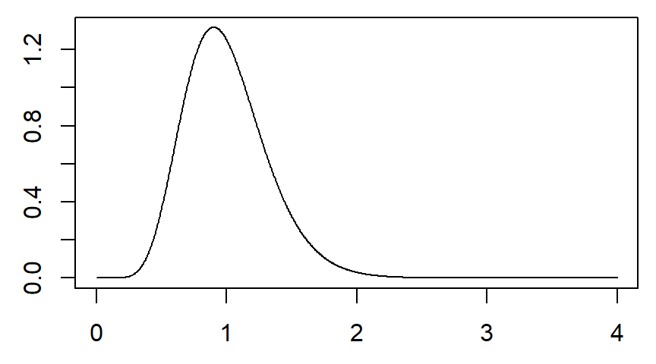
Frailty models

Slide 41
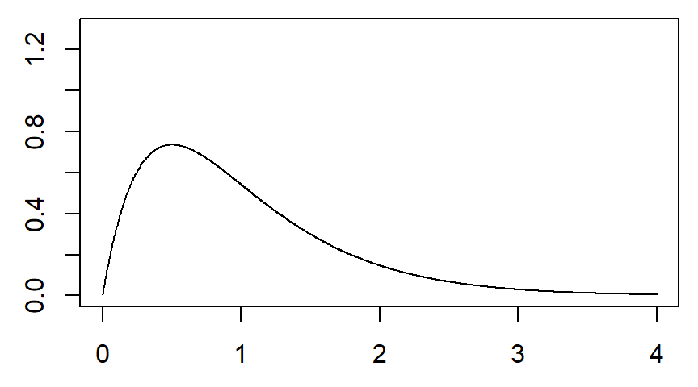
Frailty models

Slide 42
Ashkenazi data set
Frailty model
coef se(coef) se2 Chisq DF p
mutant 1.272 0.232 0.200 30.134 1 4e-08
frailty(famID) 221.500 212 0.31
Iterations: 6 outer, 26 Newton-Raphson
Variance of random effect= 0.494 I-likelihood = -3564.3
Degrees of freedom for terms= 0.7 211.6
Likelihood ratio test=400 on 212 df, p=1.17e-13 n= 3920

Slide 43
Ashkenazi data set
Frailty model (coxme)
Cox mixed-effects model fit by maximum likelihood
Data: ashkenazi
events, n = 473, 3920
Iterations= 10 63
NULL Integrated Fitted
Log-likelihood -3579.707 -3564.622 -3411.522
Chisq df p AIC BIC
Integrated loglik 30.17 2.0 2.8100e-07 26.17 17.85
Penalized loglik 336.37 150.1 2.2204e-16 36.16 -588.13

Slide 44
Ashkenazi data set
Frailty model (coxme)
Model: bc_surv ~ mutant + (1 | famID)
Fixed coefficients
coef exp(coef) se(coef) z p
mutant 1.236609 3.443914 0.2205358 5.61 2.1e-08
Random effects
Group Variable Std Dev Variance
famID Intercept 0.5912135 0.3495334

Slide 45
Rats data set
Frailty model
coef se(coef) se2 Chisq DF p
rx 0.914 0.323 0.319 8.012 1.0 0.0046
frailty(litter) 17.692 14.4 0.2443
Iterations: 6 outer, 24 Newton-Raphson
Variance of random effect= 0.499 I-likelihood = -180.8
Degrees of freedom for terms= 1.0 14.4
Likelihood ratio test=37.6 on 15.4 df, p=0.00124 n= 150

Slide 46
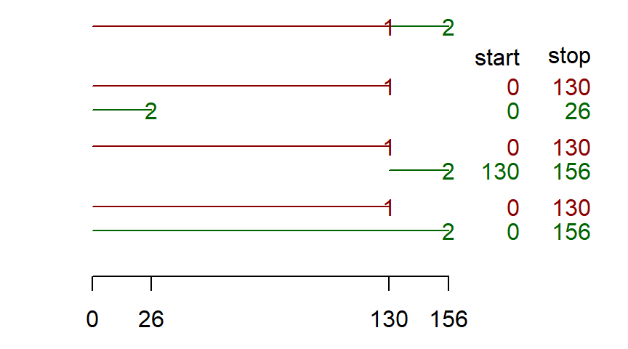
Three models for repeated events

Slide 47
Kidney data set
Frailty model
coef se(coef) se2 Chisq DF p
age 3.18e-03 1.11e-02 1.11e-02 8.14e-02 1 0.775
sex -1.48e+00 3.58e-01 3.58e-01 1.71e+01 1 3.5e-05
diseaseGN 8.80e-02 4.06e-01 4.06e-01 4.68e-02 1 0.829
diseaseAN 3.51e-01 4.00e-01 4.00e-01 7.70e-01 1 0.380
diseasePKD -1.43e+00 6.31e-01 6.31e-01 5.14e+00 1 0.023
frailty(id) 2.71e-05 0 0.933
Iterations: 6 outer, 35 Newton-Raphson
Variance of random effect= 5e-07 I-likelihood = -179.1
Degrees of freedom for terms= 1 1 3 0
Likelihood ratio test=17.6 on 5 df, p=0.00342 n= 76

Slide 48
Conclusion
What have you learned today?
Left truncation represents a setting where a patient does not enter the risk pool at t=0.
A cluster model changes the standard errors to account for correlations.
A frailty model estimates a random multiplicative term for each group.
There are three different ways to parameterize a model with repeated events.

